Slide 1
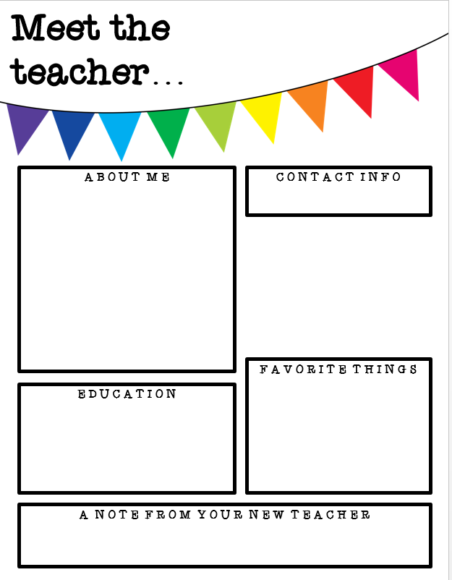
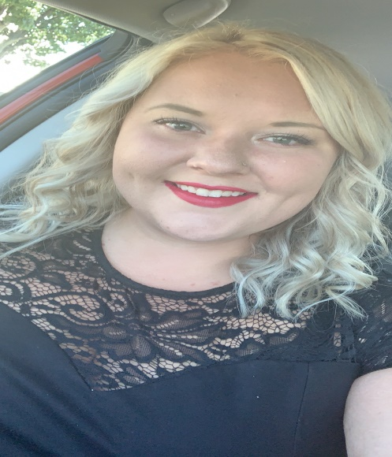
Miss Shreve
Hi! I’m Miss Shreve! I am so excited for this school year! I have been teaching learning support for 5 years. I taught emotional support at Sarah Reed for 1 year and now am excited to be teaching emotional support at Perry. I. absolutely love my job. I am thrilled to be your child’s teacher this year! This school year will be filled with fun, lots of learning, and new adventures!
kshreve@eriesd.org
Remind app
Sports
Animals
Music
Traveling
Reading
Edinboro University:
B.S in Early Childhood and Special Education
Master in Special Education- Behavior Management
Principal K-12 certificate
I am looking forward to partnering with you to create the best educational experience for your child.

